Slide 1

Update UV Stokes Imaging Polarimeter (ULTRASIP)
James Heath
1/28/2021
NASA Goddard & University of Arizona Polarization lab

Slide 2
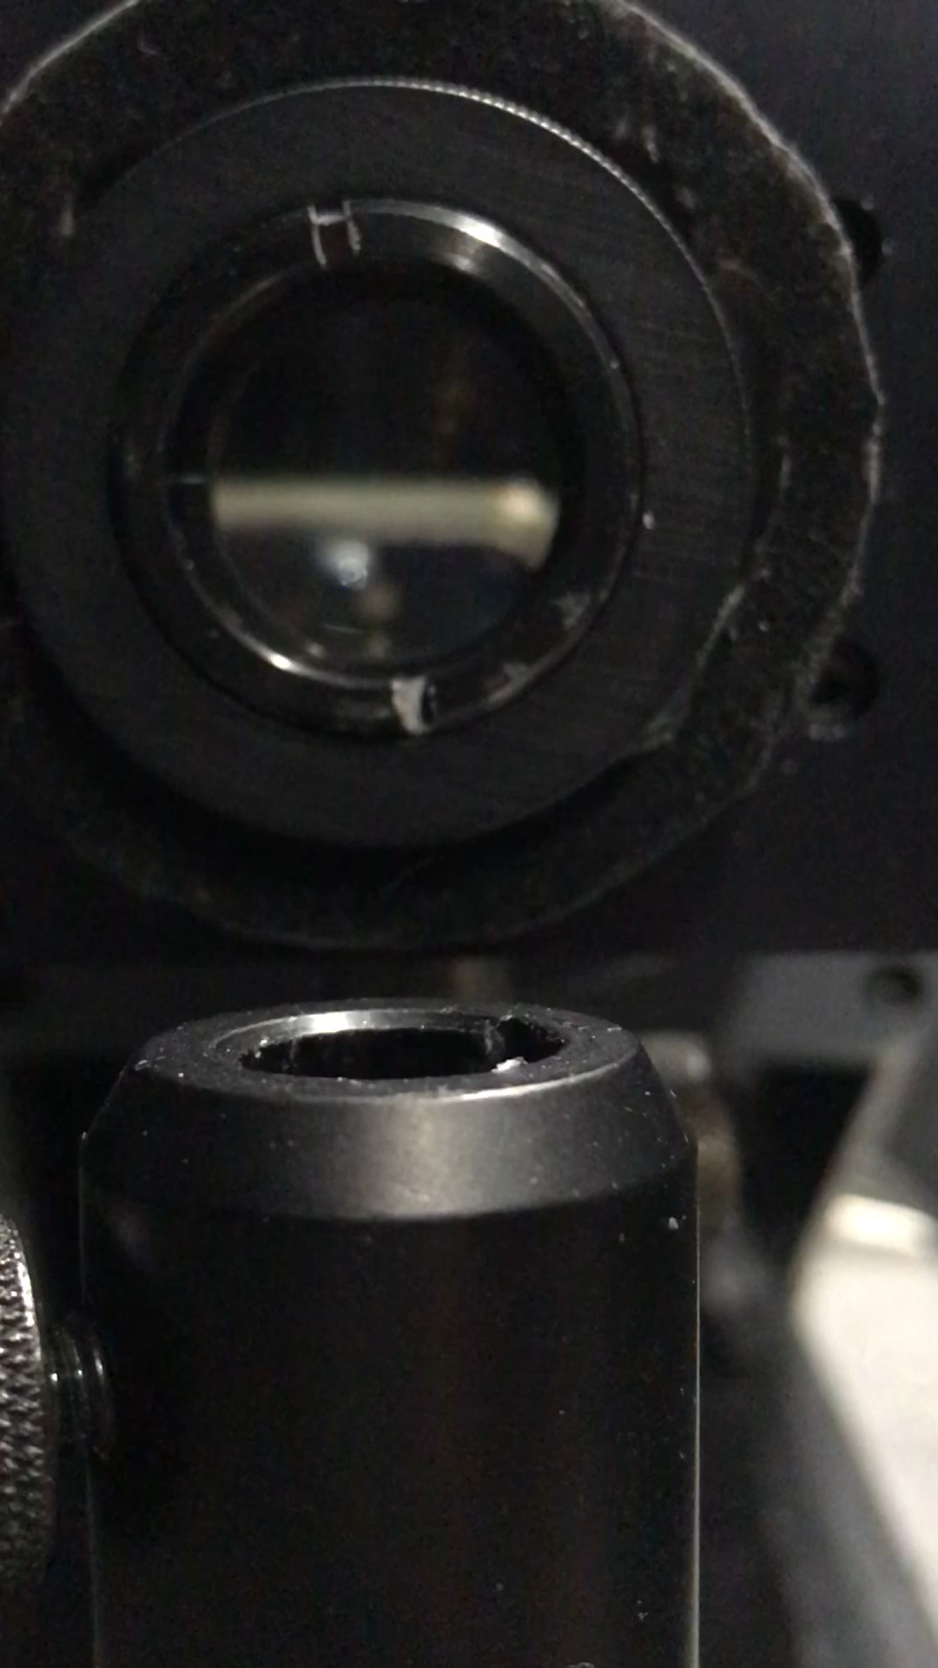
Current Progress
Linear Polarizer has been replaced with Moxtek Ultra BB LP on a motor controlled rotating holder.
Rotation seems to be working well

Slide 3
ULTRASIP program
Significant decrease in code time
Change some code with image taking to lower times from ~8s/averaged image to ~0.12s/averaged image
Motor speed has been increased from 2 deg/s to 7deg/s (This is the maximum velocity).
Lowers measurement time from ~70 to ~30 secs for 4 positions
Overall decrease in measurement time from 90 secs (last week’s measurements) to 30 secs

Slide 4
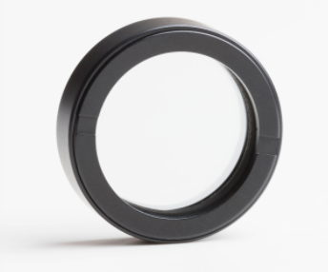
New Ultra BB LP
Moxtek Ultra Broadband Linear Polarizer (UBB01A)
Range: 300-3250 nm
Tp%: 50 @ 300 nm, 82 @ 450 nm
CR: 30 (min) @ 300 nm, 600 (min) @ 450 nm
25 mm Diameter
No more artifact in the images
Images have been much clearer

Slide 5





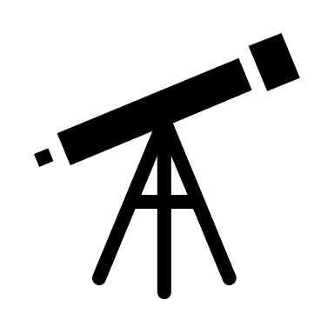

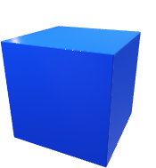
Measurement Images
Measurements: Arizona A, Basketball stadium, clouds, clouds over mountains, and sky
Exposure Time: from 0.13s and 0.23s
Measurements taken 14:00-14:24 on day one
14:00-14:24
S
2
2
55 deg
Height of sun during
measurements
W
N

Slide 6
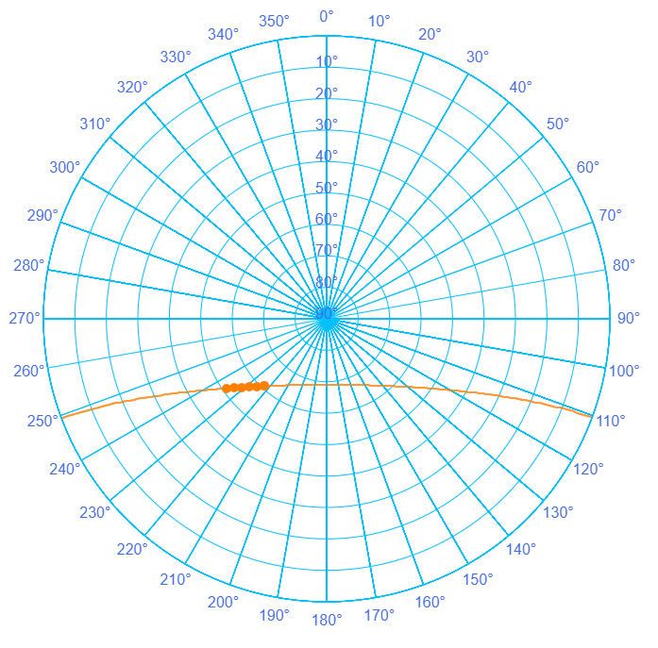
Sun location
N
14:09-14:47
W
E
S

Slide 7
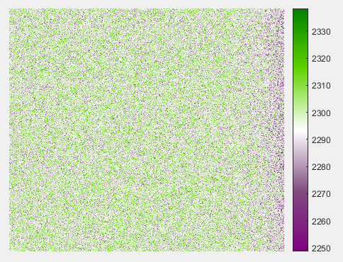
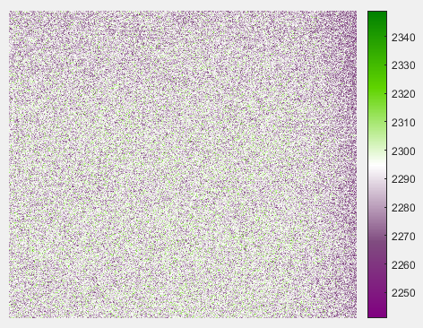
Darkfield images
0.13s
2s

Slide 8
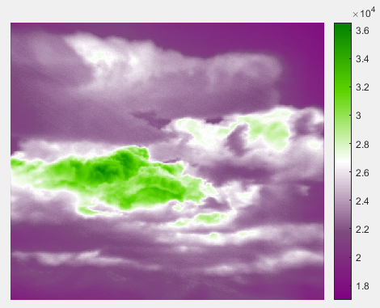
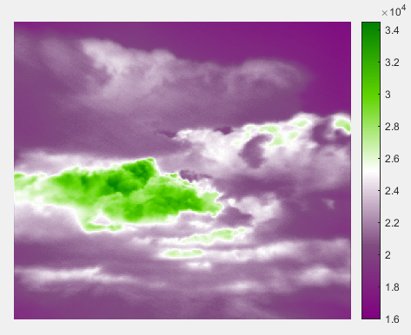
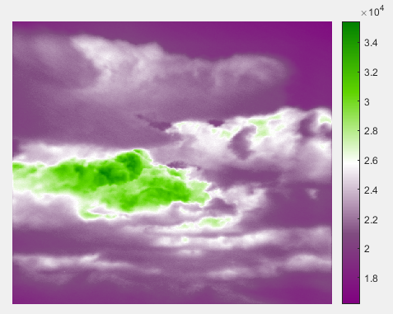
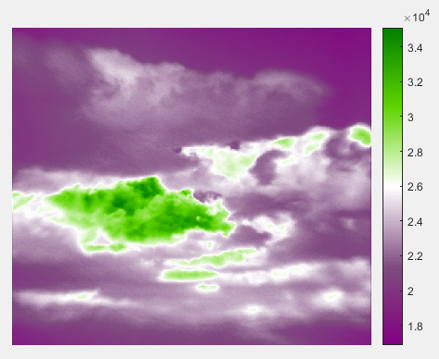
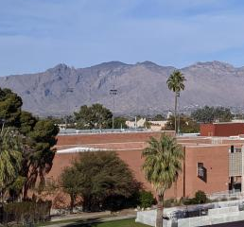
Clouds over Mountain (2s exposure)
LP = 0 deg
LP = 90 deg
Taken at: 14:02
LP = 45 deg
LP = 135 deg

Slide 9
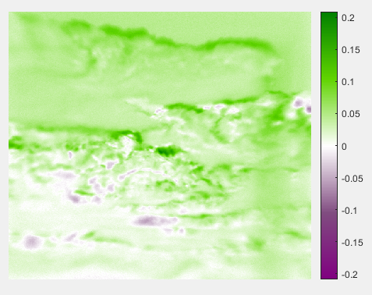
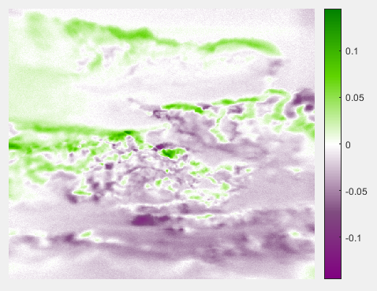
Normalized Stokes
S1 / S0 = s1
S2 / S0 = s2

Slide 10
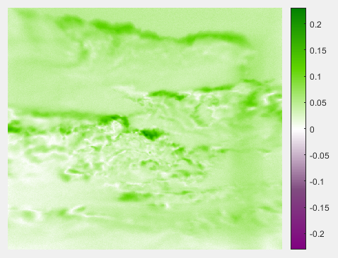
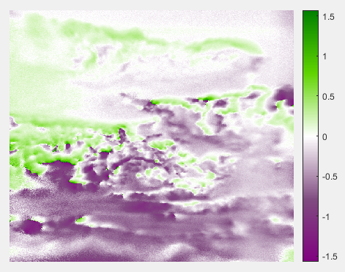
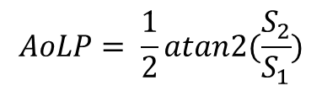
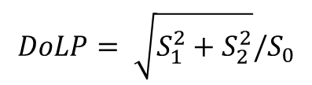
DoLP and AoLP
$$DoLP= \sqrt{S_{1}^{2}+S_{2}^{2}}/S_{0}$$
$$AoLP= \frac{1}{2}atan2(\frac{S_{2}}{S_{1}})$$

Slide 11
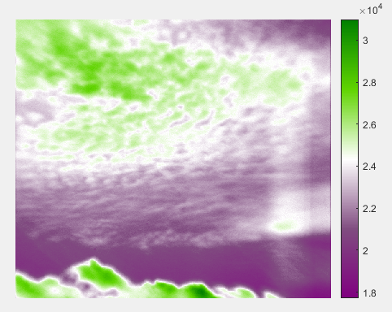
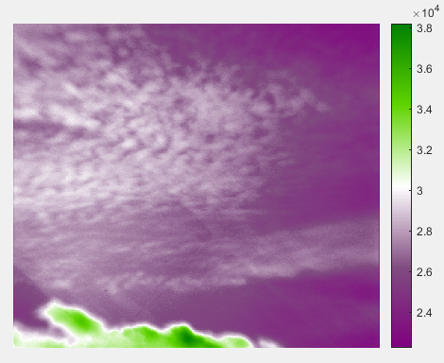
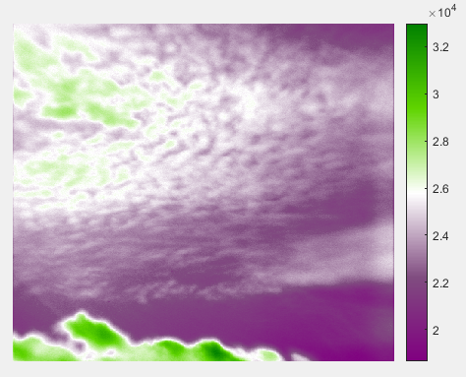
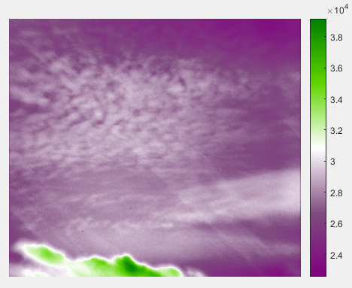
Spotty Clouds
LP = 0 deg
LP = 90 deg
Picture is of mountains almost directly north of Optics building
Time: 14:16
LP = 45 deg
LP = 135 deg

Slide 12
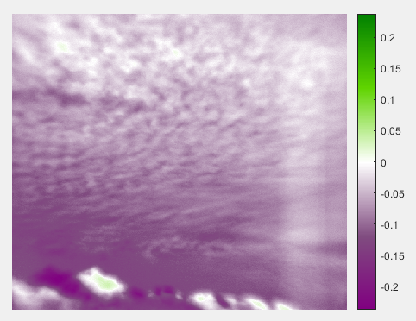
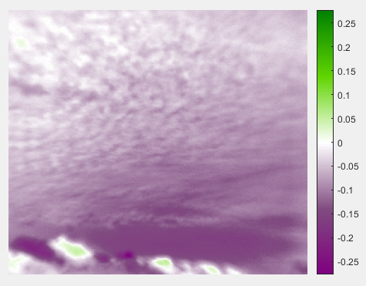
Normalized Stokes
S1 / S0 = s1
S2 / S0 = s2

Slide 13
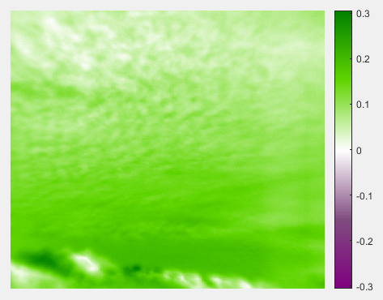
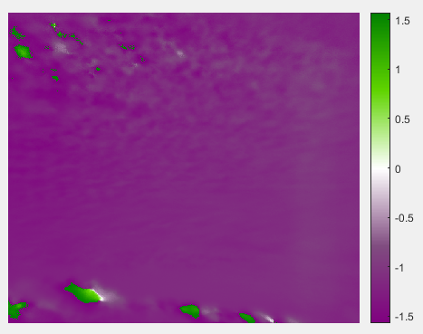
DoLP and AoLP
$$DoLP= \sqrt{S_{1}^{2}+S_{2}^{2}}/S_{0}$$
$$AoLP= \frac{1}{2}atan2(\frac{S_{2}}{S_{1}})$$

Slide 14
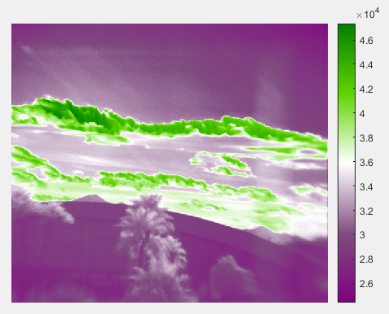
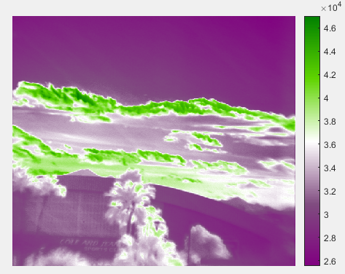
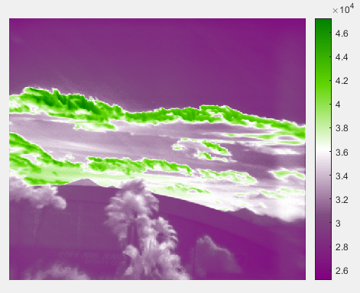
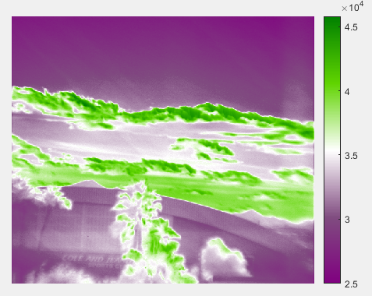
Southern Stadium Clouds
LP = 0 deg
LP = 90 deg
Picture is of mountains almost directly north of Optics building
Time: 14:32
LP = 45 deg
LP = 135 deg

Slide 15
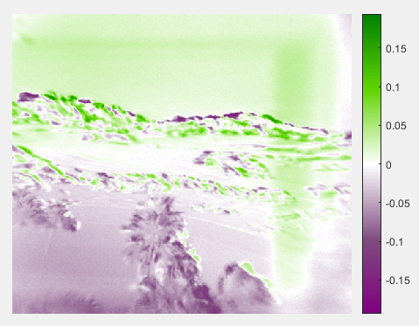
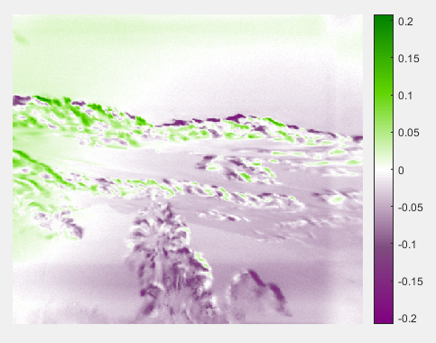
Normalized Stokes
S1 / S0 = s1
S2 / S0 = s2

Slide 16
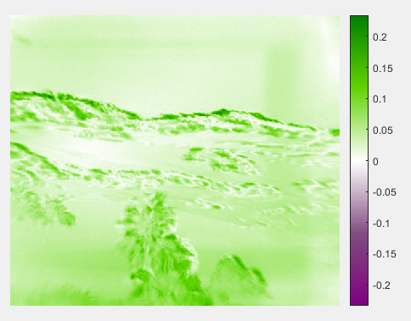
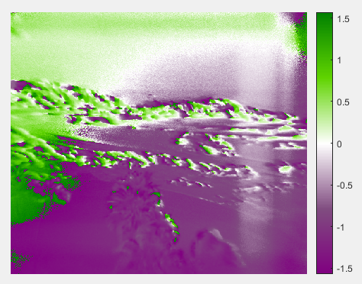
DoLP and AoLP
$$DoLP= \sqrt{S_{1}^{2}+S_{2}^{2}}/S_{0}$$
$$AoLP= \frac{1}{2}atan2(\frac{S_{2}}{S_{1}})$$

Slide 17
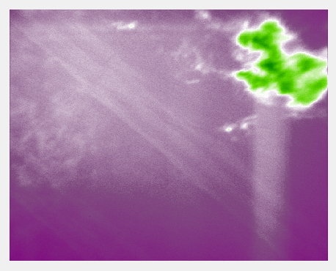
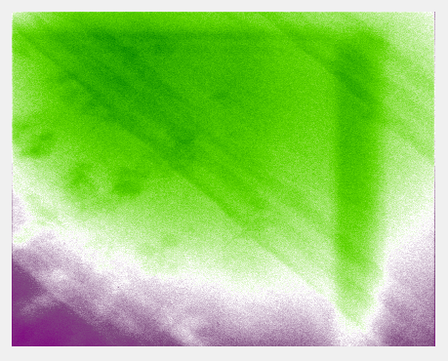
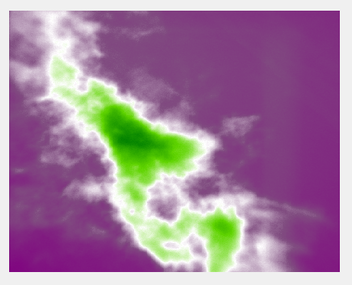
Light-bar leakage Source
Top Covered
Top Left Covered
Top Right Covered

Slide 18
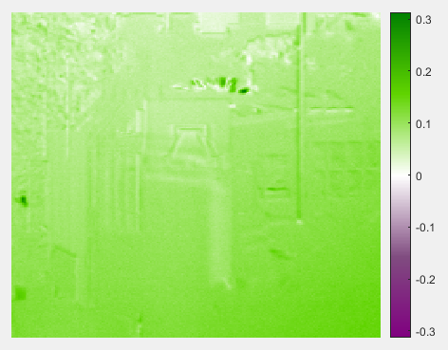
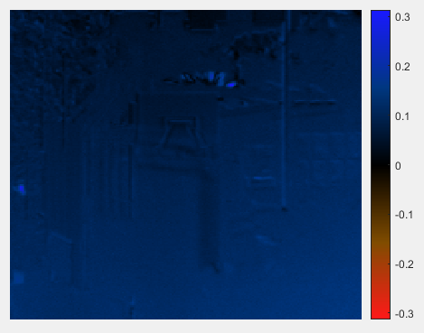
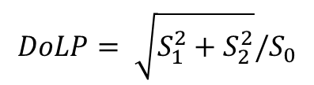
Different colormap?
$$DoLP= \sqrt{S_{1}^{2}+S_{2}^{2}}/S_{0}$$

Slide 19
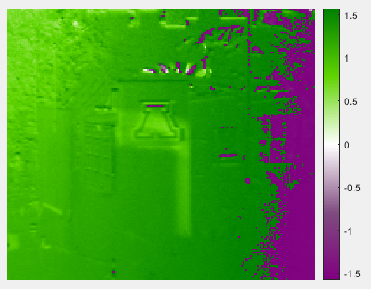
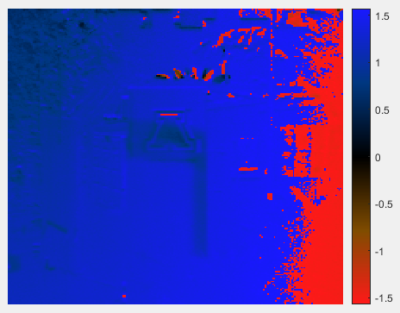
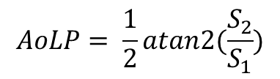
Different colormap?
$$AoLP= \frac{1}{2}atan2(\frac{S_{2}}{S_{1}})$$

Slide 20

Summary
Motor control of LP seems to work great!
Looking into and purchasing replacement parts
Low camera counts with ND filter even at lowest exposures, need to find a fix for this
Purchasing new tripod
Uniformity tests planned to see what’s happening with sky images
Colormap opinions?
Notes:
Hunt & Shaw’s paper also goes into how, from their information, you can derive droplet size retrieval from liquid clouds. I’m afraid I was unable to look into this part of the paper further however due to time constraints and will hopefully be able to include more thorough knowledge on this in the future.

